Slide 1



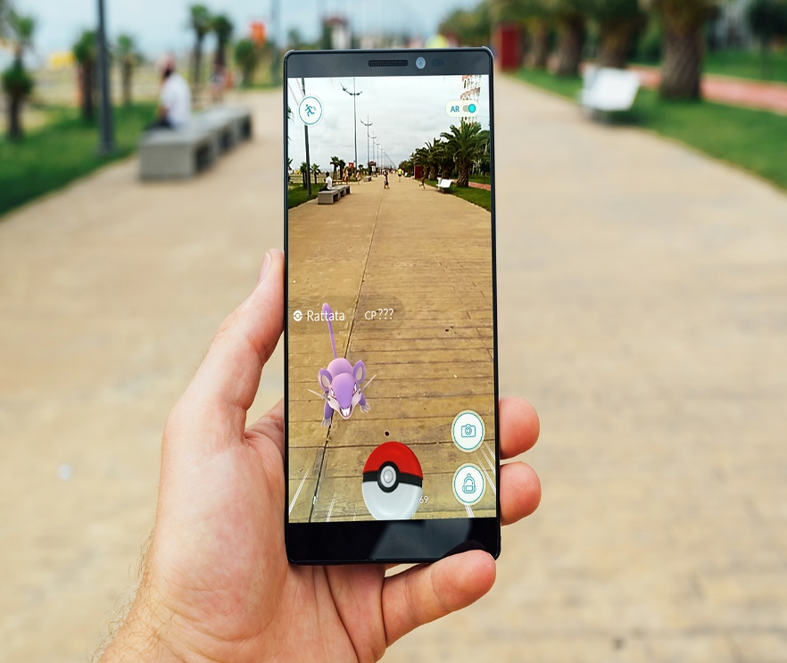



SPOORTHY ENGINEERING COLLEGE
DEPARTMENT OF COMPUTER SCIENCE AND ENGINEERING
Problem Description??
Now a days, Diabetes are the major concern in the health matters
For the people who are suffering with it, are unsure of the products they buy
Also they tend to become tense when they want to buy a product or not in such a way that it does not affect the health of them
Most of the apps present tend to show only the details of the product but not suggest the user whether it is okay to him/her or not
What we Did…
trying to do suggest the products suitable for his health for the diabetes by using an android app which also has web support
This is built upon the AR Technology.
What is AR??(Augmented Reality)
Augmented reality (AR) , is a live direct or indirect view of a physical,
real-world environment
whose elements
are augmented
by computer
generated
sensory input
How do we build this app?
First we try to know the normal sugar levels in the normal person and in diabetic person
According to the values, we try to differentiate the patients from the normal
From our add, we tend to scan the product logo or the cover from the mobile(android)
From the scanned image, If the respective logo or the image is present in the website
Then we will redirect the user to respective food product web page where we suggest the whether the food product is good or not to him
Application:
Very helpful for the diabetic patients for improving their health based upon the product selection they make from our website or app
ADVANTAGES:
Improve healthy of the diabetic
Suggesting the user to buy better products
DISADVATAGES:
The values are based upon ones perception which are applicable to only to the diabetic patients.
Other Packages and editors used in prototype:
Unity:
Vuforia:
Makers:
M. ABHISHEK ( 14N81A0549)
C. PRAVALIKA (14N81A0514)
K.RASAGNA (14N81A0532)
Acknowledgement
It is our privilege to participate in
SPOORTHY ENGINEERING COLLEGE’S SCIENCE FAIR

